Slide 1


KENYA

Slide 2
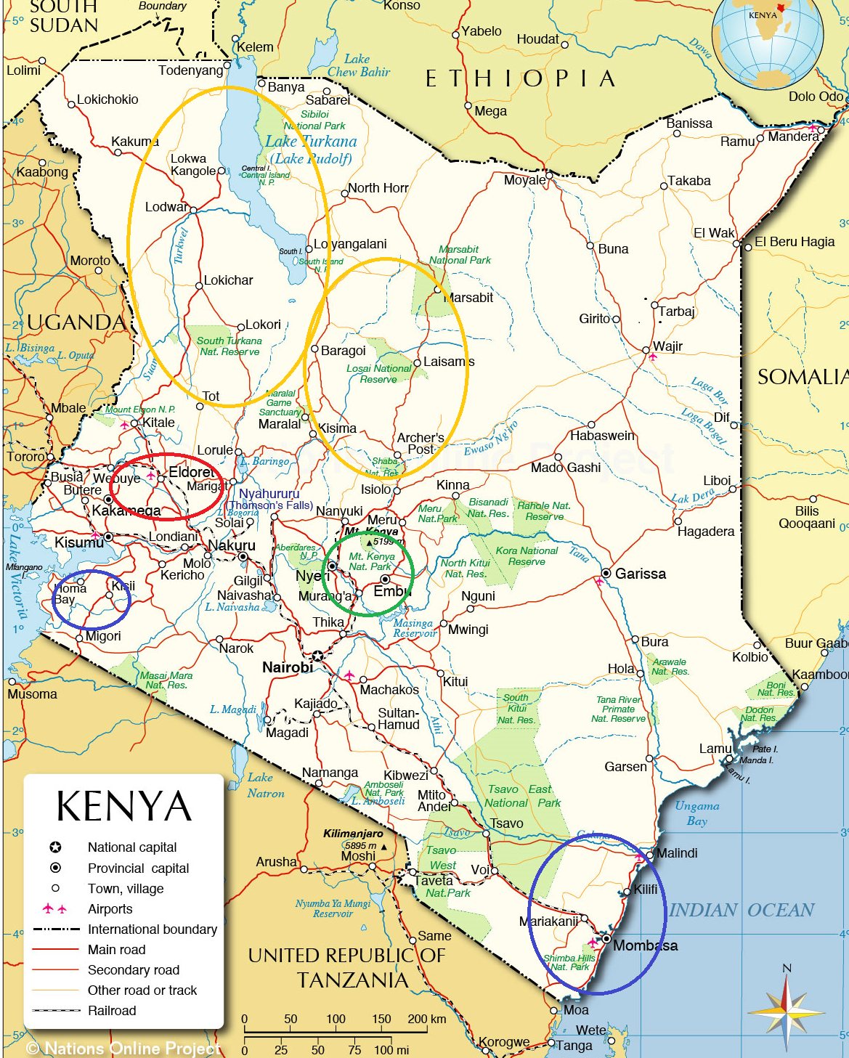
Whole Planet Foundation has four active partners in Kenya.
Each partner focuses on a different microfinance model.
We support activities in different geographic regions.
Musoni – Traditional Group Microfinance
Bidhaa Sasa – Asset Finance
The BOMA Project – Ultra Poor Graduation
One Acre Fund – Agricultural Finance
The next slides are excerpts from the proposals presented to WPF’s board to approve each project.

Slide 3
WPF Kenya Partner:
MUSONI MICROFINANCE
Type of microfinance:
TRADITIONAL GROUP LENDING MICROFINANCE

Slide 4

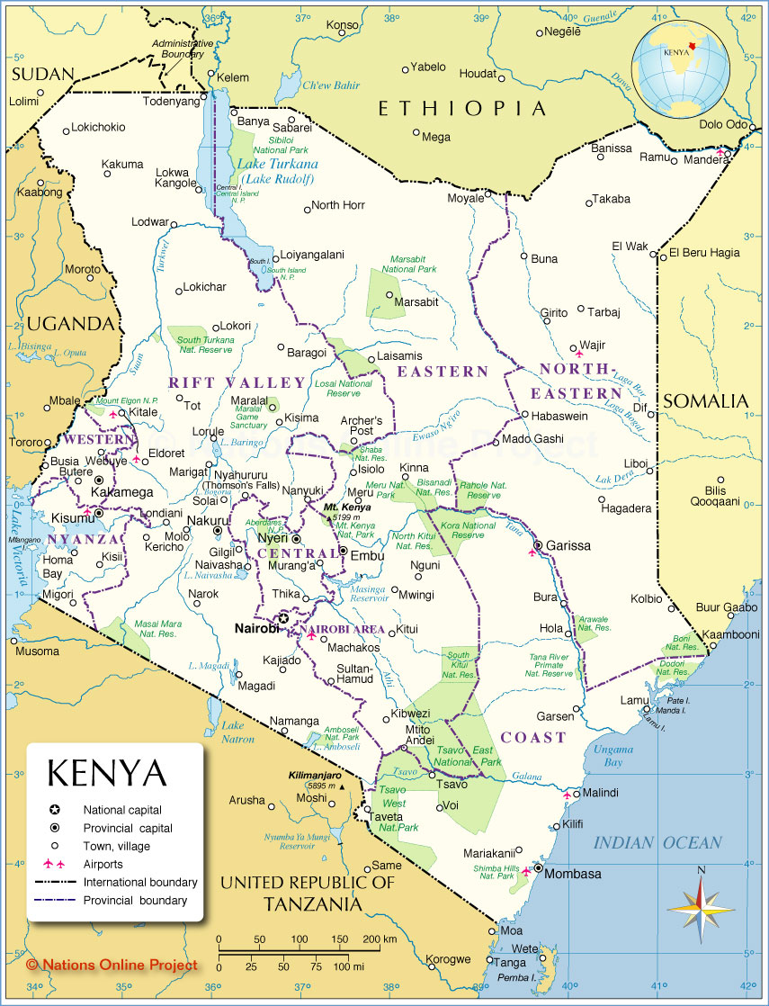
Potential Kenya G6 Project
EMPOWERING INDIVIDUALS IN THE GLOBAL COMMUNITY THROUGH ENTREPRENEURSHIP
WFM Product: Coffee
Region: Country-wide, with focus on coastal regions
Implementing Partner: Musoni
Proposal: $500,000 grant to reach 3,191 new clients
Project Justification: Musoni Kenya is an industry leader in digitized microfinance services. They recently launched the M-Nawiri product, which combines technology and high touch responsible finance best practices to deliver accessible business loans. WPF support will help Musoni scale this product to new branches in Kenya.

Slide 5

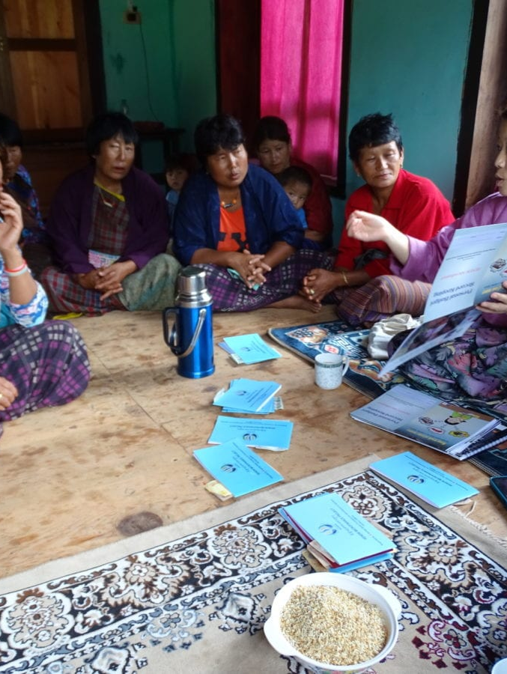




WPF Supported Model 1
Traditional Group Lending
Groups of entrepreneurs of 3-15 members accessing credit from an MFI
Potential direct access to other financial services: savings, insurance, remittances
Both joint liability and individual liability with groups there for validation and ease of management
Loan utilization focuses on income generating activities
Transactions take place in the field weekly; bi-weekly or monthly
Notes:
Typically groups of entrepreneurs of 3-15 members access credit from an MFI
Potential direct access to other financial services: savings, insurance, remittances
Both joint liability and individual liability with groups there for validation and ease of management
Groups are self-selected by the members
Entry-level loans are small dollar amounts and increase over time
Loan utilization focuses on income generating activities
Transactions take place in the field weekly; bi-weekly or monthly
Pictured: Renew Bhutan
RENEW MFI - Partner since 2015, WPF provided $300,000 in grant funds which helped establish the loan capital for four new branches.
Other examples:
South Pacific Business Development (SPBD) in Fiji
Grameen in Costa Rica and U.S.
BRAC

Slide 6
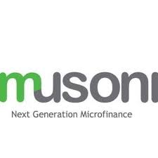
Potential Kenya G6 Project About Musoni Microfinance
EMPOWERING INDIVIDUALS IN THE GLOBAL COMMUNITY THROUGH ENTREPRENEURSHIP
Musoni Microfinance launched in Kenya in 2009, with a goal of 100% paperless and cashless services. Musoni Microfinance is partially owned by Musoni BV, which also owns the Musoni System company dedicated to developing software solutions for microfinance institutions.
The MFI now has 30 branches in Kenya and is actively opening new branches. Musoni’s loan products include business, agricultural, emergency, asset, and education loans, offered in group and individual methodologies. Some of the products are available only as top-up loans for clients with an existing business loan.
https://musoni.co.ke/

Slide 7
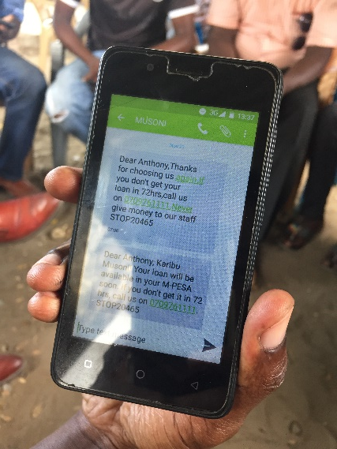
Potential Kenya G6 Project About Musoni Microfinance
EMPOWERING INDIVIDUALS IN THE GLOBAL COMMUNITY THROUGH ENTREPRENEURSHIP
Began in 2009 in Kenya
35,000+ active borrowers in 30 branches with PAR>30 at 1%, as of November 2018.
Aims to deliver cashless and paperless services to microfinance clients
Stands out in the crowded Kenyan credit market as an innovative, transparent, and socially responsible financial service provider
Affiliated with Musoni System, a popular software solution for MFIs used by many of WPF’s Africa partners.
A group meeting in Mombasa
Example of automated SMS loan notification

Slide 8
Potential Kenya G6 Project Musoni Success Factors
EMPOWERING INDIVIDUALS IN THE GLOBAL COMMUNITY THROUGH ENTREPRENEURSHIP
Meet projections for scale | The M-Nawiri product has just been launched and currently is offered in one branch. Musoni’s ability to reach growth targets is tied to successful expansion of its network through new branches. | Baseline: 220 total active new borrowers for M-Nawiri Y1: 3000 Y2: 5100 Y3: 7030
Clarify and follow through on asset collateral language and policies for M-Nawiri loan | M-Nawiri’s terms do not require asset collateral, but the contract language still contains reference to assets. Musoni management has stated they will ensure client communications and documents are consistent with the no-collateral policy. | Based on annual visit observations and review of documents
Maintain reasonable OSS and reinvest profits in growth | WPF’s decision to structure funding as a grant is based in part on Musoni’s stated strategy to maintain OSS at below 105%, reinvest profits in growth, and not pay dividends to owners. | Based on annual financial review and visit

Slide 9
WPF Kenya Partner:
BIDHAA SASA
Type of microfinance:
ASSET FINANCE

Slide 10
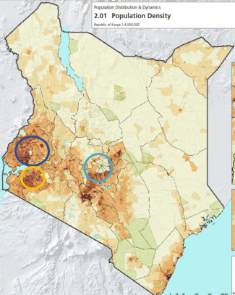
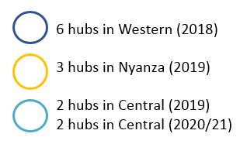
PROPOSAL: BIDHAA SASA
EMPOWERING INDIVIDUALS IN THE GLOBAL COMMUNITY THROUGH ENTREPRENEURSHIP
WFM Product: Coffee
Region: Kenya
Implementing Partner: Bidhaa Sasa
Proposal: $180,000, 4920 borrowers
Project Justification: Bidhaa Sasa offers high quality assets to low-income populations in rural Kenya through Grameen style group lending. They offer competitive pricing, standalone asset loans, and year-round on demand delivery and repair, in a market where many of these services are not available.

Slide 11
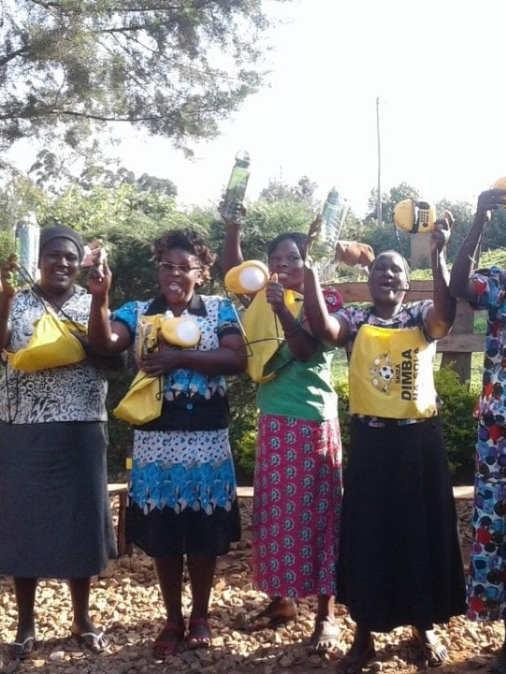



WPF Supported Model 3
Asset Finance
Offers business assets on credit rather than cash loans or establishes micro-franchise type business
Catalogue of products including clean cook stoves/ solar/ farming equipment
Ex: “Business in a box” i.e. creating new replicable businesses that clients can launch and profit from
Last-mile distribution of quality durable productive assets
Notes:
Administered by early stage social enterprises
Offers business assets on credit rather than cash loans or establishes micro-franchise type business
Catalogue of products including clean cook stoves/ solar/ farming equipment
Ex: “Business in a box” i.e. creating new replicable businesses that clients can launch and profit from
Last-mile distribution of quality durable productive assets
Pictured: Kenya: Bidhaa Sassa
Bidhaa Sasa sells, delivers, and finances beneficial products to low income populations in rural areas. Our team likes their client-centric approach to affordable credit, responsive customer service, and attention to internal systems.
All of their products are selected for their productive time and money savings benefits, and are priced under 10,000 Kenyan shillings, or roughly $100. They currently offer solar products, gas and efficient cookstoves, and maize drying tarps. And they are continuing to test new products to add to the mix. Since they first launched in 2015, Bidhaa Sasa has sold a total of 12,000 products. WPF support will help Bidhaa Sasa reach 4920 new borrowers access these beneficial products.
Other examples: Jiro-Ve Madagascar; Access to Energy Philippines

Slide 12
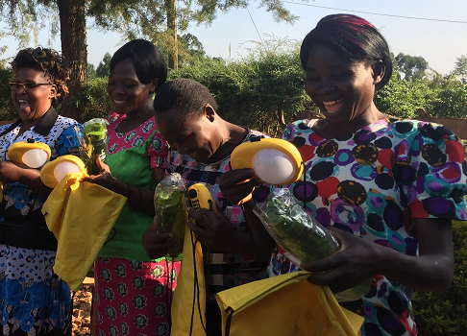
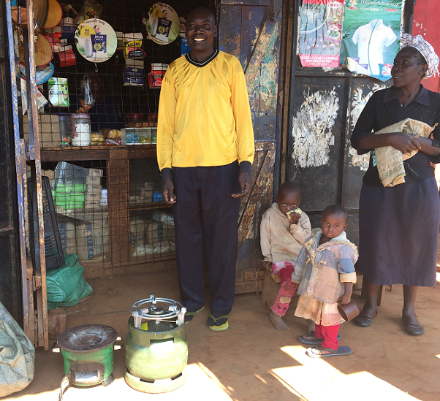
Potential Kenya G5 Project About Bidhaa Sasa
EMPOWERING INDIVIDUALS IN THE GLOBAL COMMUNITY THROUGH ENTREPRENEURSHIP
Bidhaa Sasa launched operations in Western Kenya in 2015.
They offer affordable, high-quality products to rural clients using Grameen style small group credit.
Products are available on demand, year- round, and are all below $100.
As of 5/31/2018, the company has sold almost 12,000 products on credit to farmers and other rural clients.
Products are carefully selected for beneficial qualities, and include solar lamps and radios, and efficient cook stoves.

Slide 13
Potential Kenya G5 Project Bidhaa Sasa Success Factors
EMPOWERING INDIVIDUALS IN THE GLOBAL COMMUNITY THROUGH ENTREPRENEURSHIP
Meet projections for scale | Bidhaa Sasa hopes to more than double their borrower base every year for the first two years of the project. Their ability to scale is key to sustainability of their model, which focuses on low ticket items and high touch service. | Baseline: 4,218 (active borrowers, global) Y1: 11,399 Y2: 27,223 Y3: 34,778
Improve and maintain portfolio quality and reduce PAR | Bidhaa Sasa’s current PAR of 9.4% is lower than other asset finance partners in the WPF Africa portfolio, but still higher than their internal target of 7%. BD continues to train staff and fine tune their model to improve repayment rates | Baseline: PAR>30 = 9.4% Y1: 8% Y2: 7% Y3: 7%
Standardize implementation of policies and processes | Some of the loan approval procedures were not standardized across different staff and branches. Such differences can cause portfolio quality problems which may be amplified as operations scale up. BS is aware of these inconsistencies and has actively worked with staff through refresher trainings to strengthen compliance. | Based on annual field visit observations
Improve delivery logistics | Currently Bidhaa Sasa relies on a third party logistics company for field deliveries, but the service is often inconsistent. As Bidhaa Sasa grows they are hoping to build out their internal logistics capacity. | Based on annual field visit observations

Slide 14
WPF Kenya Partner:
THE BOMA PROJECT
Type of microfinance:
ULTRA POOR GRADUATION MODEL

Slide 15
PROPOSAL: BOMA
WFM Product: Coffee
Regions: Samburu and Turkana
Implementing Partner: The BOMA Project
Proposal: $427,695 three-year grant to provide business start-up assets for 3915 graduation program participants
Project Justification: This will be WPF’s second project with BOMA. We will support entrepreneurs in Samburu and Turkana, two of the poorest counties in the country. In Samburu, our support will contribute to climate change resilience adaptations of BOMA’s core program.
BOMA works in the dryland communities in Kenya which have very low access to market and services. All participants are women who earn less than $1.90 a day before they join. BOMA has a strong track record in helping entrepreneurs start and sustain businesses.

Slide 16

PROPOSAL: BOMA
The BOMA Project launched in 2005, with the goal of creating pathways out of poverty for women living in the northern drylands. In late 2008, BOMA started implementing REAP, their ultra-poor graduation methodology. This approach’s impact is backed by rigorous research. BOMA scales their approach through direct implementation and strategic partnerships.
Website: https://bomaproject.org/

Slide 17
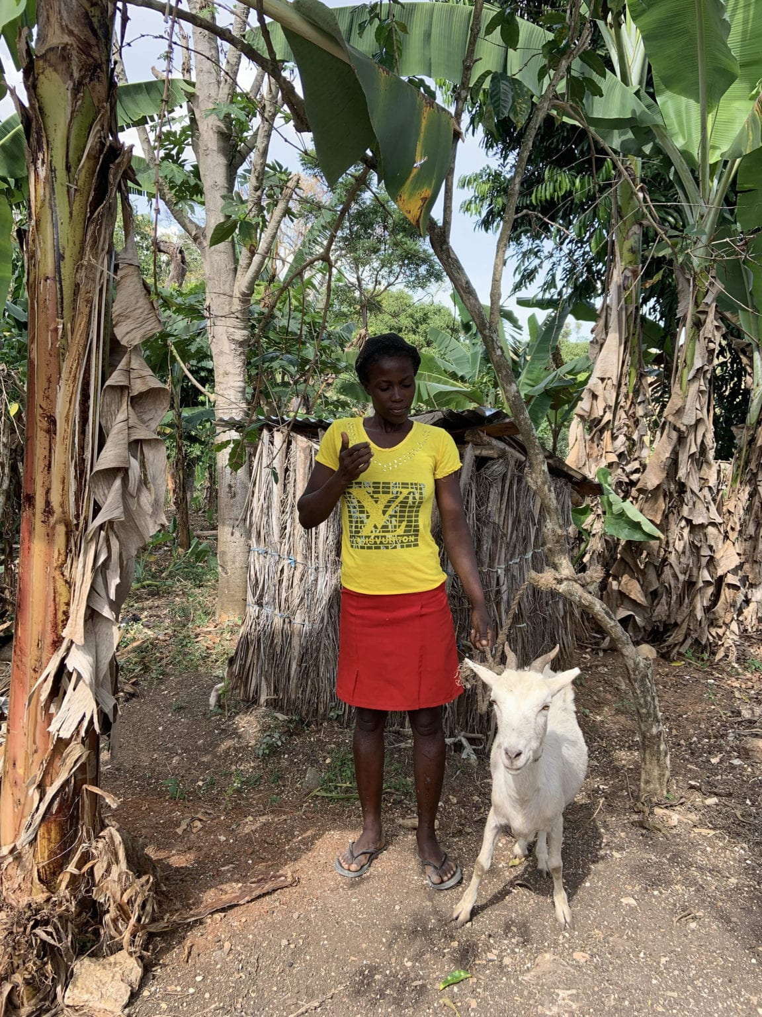



PROPOSAL: BOMA
Ultra Poor Graduation Model
Focus on the absolute poorest of the por
Extensive targeting
Asset/grant transfer (cow, goats, farming assets)
Skills development
Access to savings
12 - 24 month intervention
Creating a pathway for the ultra poor to reach financial inclusion
Notes:
Focus on the absolute poorest of the por
Extensive targeting
Asset/grant transfer (cow, goats, farming assets)
Skills development to generate income and build livelihood
Access to savings
12-24 month intervention
Creating a pathway for the ultra poor to reach the first rung of financial inclusion
Pictured: In a country like Haiti, with a lack of national social assistance for the poor, households must be self-reliant and proactive to prepare for shocks. Fonkoze Foundation’s Chemen Lavi Miyò “CLM” program is part of the solution to this challenge as they work to support Haitian women to not only to climb out of ultra-poverty but also to prepare for hard times. As an 18-month “Ultra-Poor Graduation” program, CLM has enabled over 8,000 women (previously living on little to no income) to ensure their families have at least 1 hot meal per day, adequate housing, access to clean water, growing assets, kids enrolled in school, proper nutrition and legal identification.

Slide 18
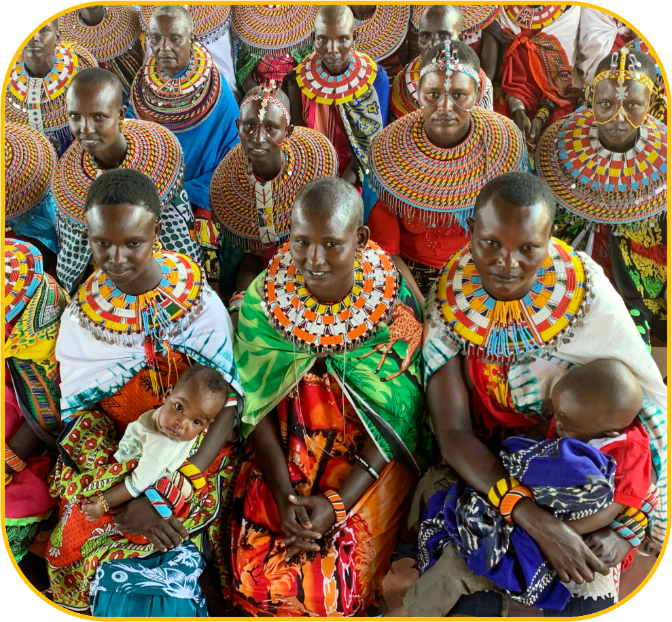
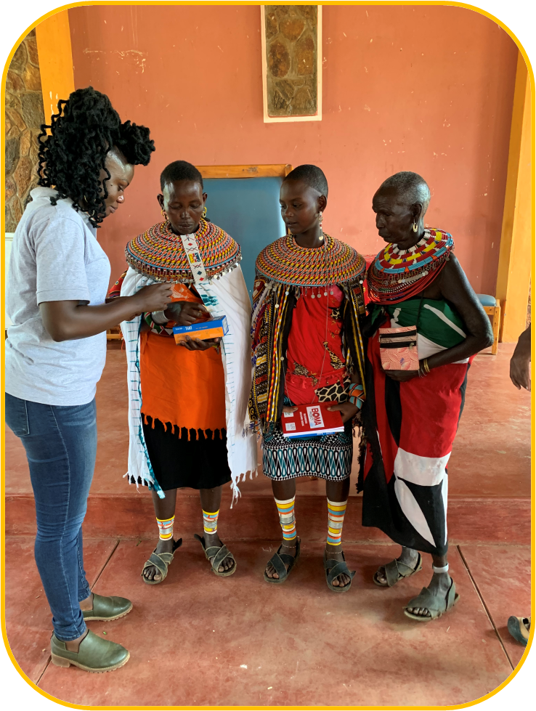
About The BOMA Project
The BOMA Project began in Kenya and US in 2005.
100% of participants are women living on less than $1.90 a day when they join the program.
Since inception, BOMA has reached 34,203 participants with a 93% graduation rate (as of the most recent fiscal year ending September 2020).
BOMA’s proprietary and robust MIS monitoring tool is well respected in the graduation space.
BOMA works in the remote drylands of Kenya which are often isolated from services and infrastructure. The region faced many challenges in 2020: locust swarms, drought and flood, and COVID.
They actively connect participants and graduates to external sources of business credit.

Slide 19
Project Success Factors
Continue to secure diverse, mission aligned sources of funding | BOMA’s has plans to rapidly grow direct implementation outreach in the next two years, including into several new counties where they had previously provided technical assistance. Their operations are highly dependent on grant funding. | Based on annual financial review
Completion of NRM pilot; share impact analysis and next programmatic steps | This project supports a pilot natural resources management adaptation in Samburu. At the end of this project, the WPF team requests an update on learnings, impact analysis, and any planned scale up of this pilot. | Based on end of project review.
Strengthen digital financial literacy training for participants | BOMA provides each participant with a mobile phone and access to a mobile money account. Digital financial literacy training is needed to ensure participants can navigate their accounts and are protected from mobile money fraud, which is prevalent in Kenya. | Based on annual review
Continued expansion of linkages to external financial services and credit | BOMA ran a successful pilot in Samburu to help participants connect with external loans through local microcredit providers. Before the pandemic, they had considered expanding this service to other areas. | Based on annual review

Slide 20
WPF Kenya Partner:
ONE ACRE FUND KENYA
Type of microfinance:
AGRICULTURAL FINANCE

Slide 21
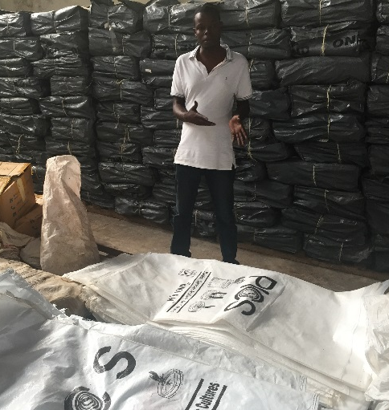
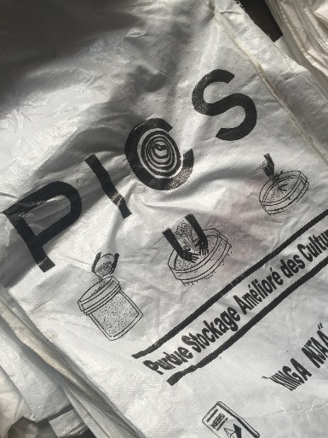
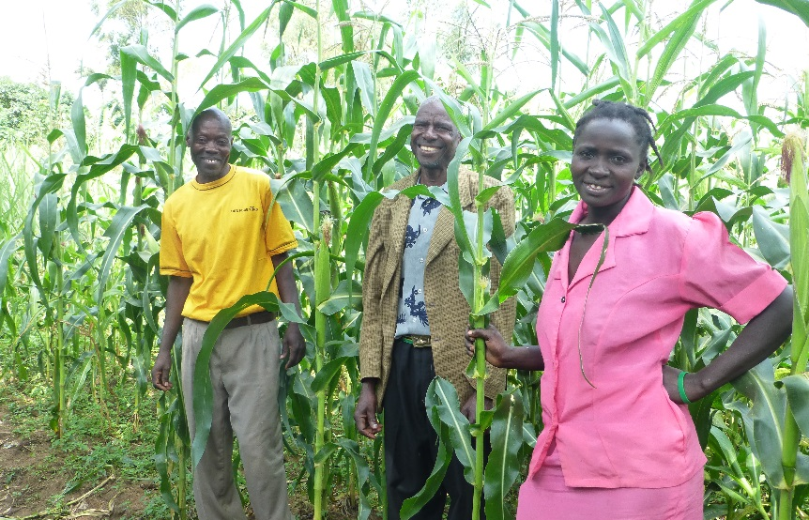
PROPOSAL – ONE ACRE FUND KENYA
EMPOWERING INDIVIDUALS IN THE GLOBAL COMMUNITY THROUGH ENTREPRENEURSHIP
Began in 2006, storage loan first piloted in 2012.
Lend small farmers key agriculture inputs, paired with intensive farm training and mentoring through a traditional group loan model requiring no collateral. The program also offers add-on products like solar lamps and storage loans for interested clients.
As of 9/30/2016, 209,206 active farmer clients and $20,418,536 in active loans
Repayment rate of 98%
Above: Specialized maize storage bags
Notes:
From Zoe SO: “The OAF Kenya proposal was initially for a maize storage loan, but we eventually switched back to supporting a more typical input loan mid-project.”

Slide 22
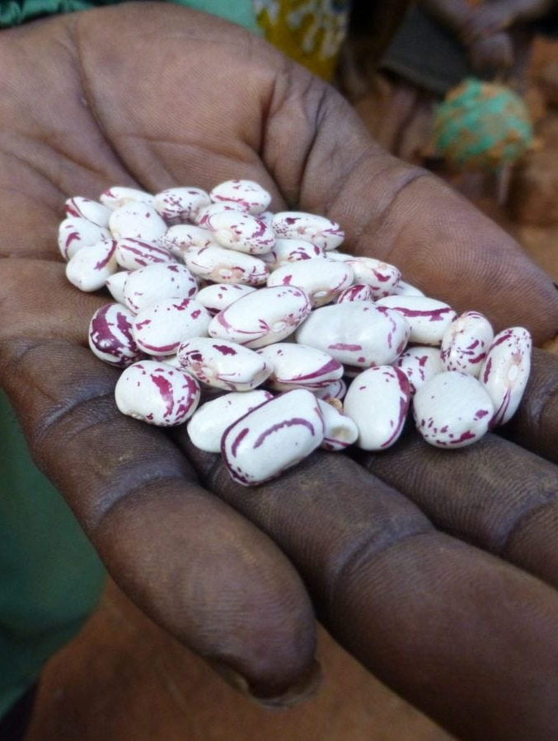



WPF Supported Model 4
Agricultural Finance
Combines the business models of an agribusiness and an MFI, providing inputs like seed and fertilizer on credit
Agriculture financial services include but are not limited to:
* Seasonal cash loans
* In-kind input credit
* Layaway
* Post-harvest credit advance
Notes:
Combines the business models of an agribusiness and a microcredit institution, providing inputs like seed and fertilizer on credit
Clients (farmers) receive training and supply chain linkages
Credit is structured according to seasonal cash flow.
Agriculture financial services include but are not limited to:
Seasonal cash loans –Typically implemented by MFIs
In-kind input credit
Layaway
Post-harvest credit advance – Usually part of a comprehensive full cycle package offered by an aggregator.
Pictured: One Acre Fund Burundi provides inputs, like seeds and fertilizer, to its clients.
In our ag finance portfolio, we typically seek to support access to credit for smallholder famers which is structured according to seasonal cash flow. Thus far we have funded a few types of agriculture financial services:
Seasonal cash loans –Typically implemented by MFIs.
In-kind input credit
Layaway
Post-harvest credit advance – Usually part of a comprehensive full cycle package offered by an aggregator.

